Slide 1



Innovation For A Highly Connected World
Sean Cai
VP & GM, CTO Group, ZTE
28 September, 2016

Slide 2
Innovations in technology, application & business
Advanced Technologies
Application Scenarios
Business Models

Slide 3
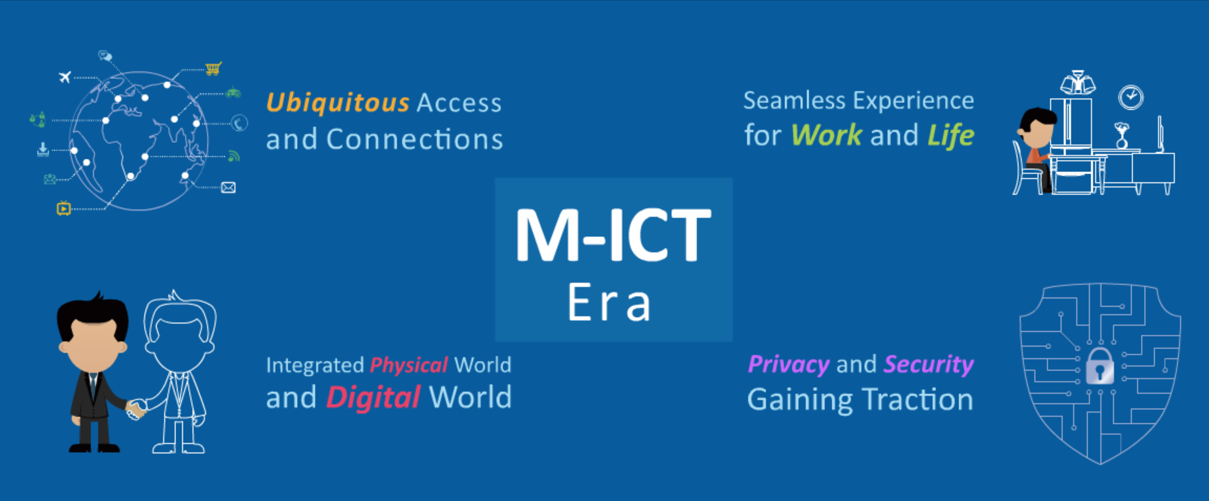
Increasingly connected lifestyle

Slide 4
Technology innovations towards 5G
Pre-5G
Undefined
5G
2012
2017
2010
4G+
LTE-A
4G
LTE
2020
Meet growing capacity demands before 5G
Based on 4G+ networks
Bring forward some 5G technologies
Speed x10~100
Capacity x1000
Billions connected
Service oriented networks
Features: CoMP, CA
Higher performance
Larger coverage
Higher spectrum efficiency
LTE commercial available

Slide 5
Technologies enabling 5G & beyond
RAN architecture & RAN sharing
  HetNet, CoMP, Small cells, Relay, …
RRM & interference cancellation techniques
  Interference management, ICIC, eICIC, AI, …
PHY technologies
  Massive MIMO, AAS, Full-duplex, …
Spectrum usage & spectrum sharing
  FDD/TDD CA, LSA, …

Slide 6
Spectrum Challenges for 5G
Over 30 Spectrum Bands for LTE Deployment
  Major LTE frequency bands
    700MHz/800MHz/900MHz/1.8GHz/2.1GHz/2.3GHz/2.6GHz
    Channel bandwidths: 10MHz/20MHz/others NB-LTE
    Possible spectrum re-farming, potential band interference
  Smartphone design challenges
    GSM/CDMA, UMTS, WiFi, Bluetooth and GPS radio/ band combinations
    Challenges of ecosystem & economies of scale
FDD/TDD Challenges
  Different Carrier Aggregation proposals
  Overall ecosystem & global inter-operability between networks

Slide 7






Big data based network for future business models
NaaS
BaaS
DaaS
Capability Open Platform(iTOP)
Orchestration & Management
NSO
BSS
Big Data
SDNC
OSS
Management Layer
Network Slice 1
Network Slice 2
CMP
MANO
Agt
CMP6
CMP7
CMPe
CMPf
CMPiii
CMPiv
MANO
CMP4
CMP5
CMPc
CMPd
Service Layer
CMP
MANO
Agt
CMP
SDNC
CMP1
CMP2
CMP3
MANO
…
CMPa
CMPb
MANO
…
CMPi
CMPii
MANO
Access Cloud
Edge Data Center
Region Data Center
Center Data Center
NFVI
SDNC
NFVI
SDNC
NFVI
SDNC
Service Chain
Service Chain
Service Chain
RRU/PicoRRU
BBU Pool
TC/TF
TC/TF
TC/TF
CMP-Component
Enterprise Cloud
Backhaul
Metropolitan IP Network
Core IP Network
Bearer Layer
Transportation NW (IP and Optical)
Access
Metropolitan Optical Fiber Network
Trunk optical Fiber network
Notes:
在了解了数字化经济的基本现状和转型原则后，我们具体建议运营商可以从如下方面入手：
首先厘清各个垂直行业纠缠在一起的能力，从而找出自身的特点和优势。这个可以利用前面介绍的3C模型，4-dimension评估等方法
找到数字化经济下，自身愿意并且能提供的能力，并进行分解/映射到运营商自身不同的能力层面上——资源（resource），基础连接（connection），入口（portal/entry），上层能力（api。。。）
执行上述动作的驱动力，主要来自文化转型（culture shift），颠覆性变革（disruption，包括：技术，商务模式等多个方面），以及最终客户的需求（尤其是出于本性-nature behavior的需求）
这些能力的分层封装的过程主要是运营商内部的改变过程，主要是考虑其自身的interlocking issue（策略，技能，资金）这几个方面
重新规划整理过的运营商能力，需要按照市场意愿进一步封装成数字化经济需要的服务（service），而这些服务可以按照市场化的要求进行分类（如：LBS，Big-data等）
最终这些服务可以以PaaS，SaaS，IaaS的方式参与到数字化经济活动当中。尤其是NFV/SDN是当前比较热门和可行的方法。

Slide 8


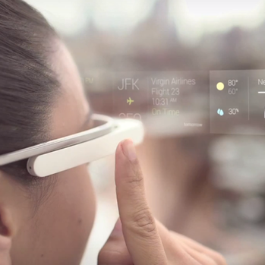

Innovations driving global network transformation
Next-Gen Operations
and
Services
Digital Services
(SNS, Video, VR, AR, Cloud Services, Data Monetization)
Ubiquitous connectivity for billions by 2020
Seamless experience for life and work
Virtualization
and
Software Defined Network
Convergence and interaction of physical world and digital world
Network security and privacy comes into the spotlight
Ubiquitous Connectivity

Slide 9



Thank you

