Slide 1
Innovation Forum
The Kyunghyang Shinmun
“The New Normal Era: Innovation and Insights”
Innovation Management in New Normal Era
at Japanese Manufacturing Firms
September 2016
Kentaro Nobeoka
Professor & Director
Institute of Innovation Research
Hitotsubashi University

Slide 2
Main Points of my Presentation
Innovation in Japan has been stagnating for the last 20 years
Japanese firms are good at “value creation,” but not at “value capture”
From the “product architecture” perspective, Japanese firms are good at “integral” design but not at “modular” design
New Normal Era: Non-functional customer value (emotional, intangible, subjective, solution, consulting, service) is critical

Slide 3
Value Creation Performance of Japanese Manufacturers
(Source: Ministry of Finance)
ROS (Operating Income/Sales)
Value Added/Sales
Value Added/Sales
ROS (Operating Profit/Sales)

Slide 4
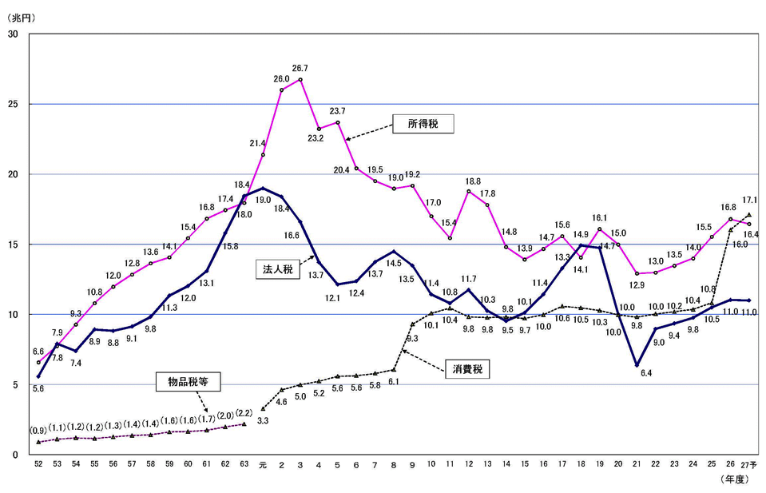
Japanese Tax Revenue
Trillion Yen (US$10 billion)
Income Tax
Corporate Tax
Consumption Tax (old)
Consumption Tax
1980
1985
1990
1995
2000
2005
2010
2015
https://www.mof.go.jp/tax_policy/summary/condition/011.htm

Slide 5
Definition of Innovation
Innovation = Invention + Exploitation
(Roberts, MIT, 1970s)
Innovation = Value Creation + Value Capture
(Henderson, MIT, 1990s)
Innovation = Functional Value + Customer Value
(Nobeoka, 2000s)

Slide 6
Value Creation and Value Capture: Low Correlation after mid-1990s
Apple
High
（90s〜）
（〜90s)
Toyota
Samsung
Hisense
Value Capture
(Value added/Profit)
Panasonic
NEC
Hitachi
Low
Poor
Excellent
Value Creation
(Product Function/
Technology/Manufacturing)

Slide 7
5 Biggest Electronics and Automobiles Firms (Sales)
Trillion Yen (about 10 billion US$)
Toyota, Nissan, Honda, Mazda, Subaru
Panasonic, Sony, Hitachi, Toshiba, NEC

Slide 8
5 Biggest Electronics and Automobiles (Operating Profit)
Trillion Yen (about 10 billion US$)
Toyota, Nissan, Honda, Mazda, Subaru
Panasonic, Sony, Hitachi, Toshiba, NEC

Slide 9
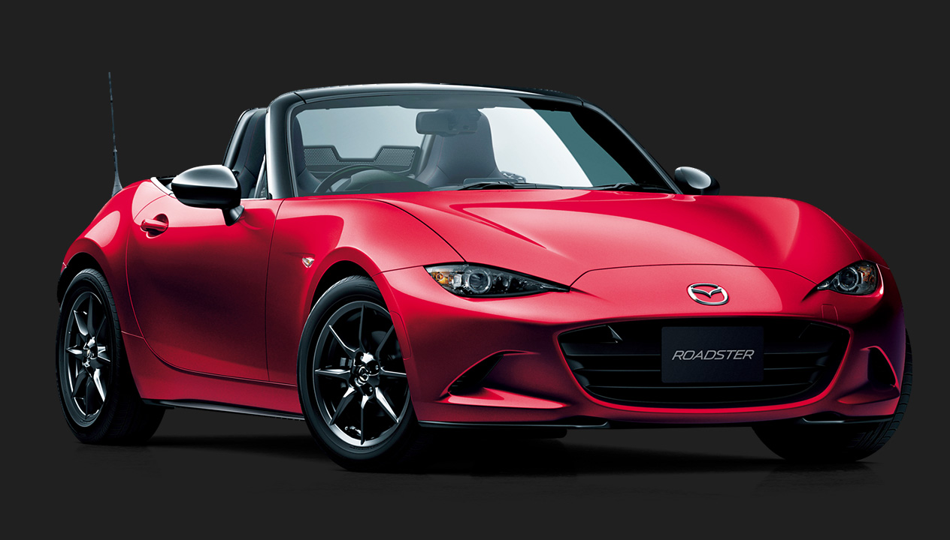
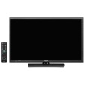
Value Creation with Integral Design and Subjective Value
(Apple)
Japan: Strong
Complex
(Subjective/ Intangible)
Automobile
Customer Value
Simple
(Function Only)
Electronics
Simple
(Modular)
Complex
(Integral)
Technology / Design Architecture

Slide 10

“Product Architecture” and Organizational Capability
Coordination & Integration
Solutions
Materials
Automobile
Integral
(Analogue)
Copy/Printer
TV-game /
Trad. Car navigation
Product
Architecture
Digital Camera
LCD TV
Mobile Phone
Modular
(Digital)
DVD player
Desktop PC
Selection & Combination
Standard
Customized
1. Cost (Chinese)
2. Global business system (Dell)
3. Platform leadership (Intel)
Component Characteristics

Slide 11
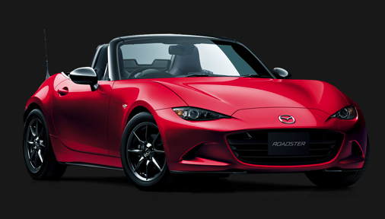
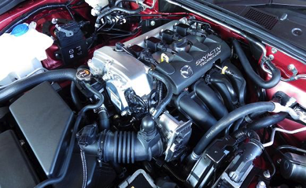
Cars: Why Integral? <One Example>
Customers in the US would pay for additional $3,000 for good styling, which needs “lower hood height.”
http://www.mazda.co.jp/cars/roadster/grade/#roadster
Engine, Transmission, Suspension, Brakes, Air Conditioner, Radiator, etc.
Coordination needed.
Product Development Hours
Japan: 1.2 million hours
USA: 2.7 million hours
Europe: 3.6 million hours
(Source: Fujimoto & Nobeoka, 2006)
http://gazoo.com/car/newcar/impression/st2/Pages/WCG_151214.aspx

Slide 12
Functional Value (Objective) vs. Non-Functional (Subjective) Value
Function Objective Tangible Catalog value
Non-Function Subjective Intangible
B2C Emotion
B2B Solution
High
Price
(Customer Value)
Non-functional
Subjective Value
Low
Functional Value
Only Functional Value
w/ subjective Value
Low
High
Major Function / Specifications

Slide 13
New Normal Era: Non-functional Value is Critical
More sophisticated value is needed and wanted by customers.
Functional value alone cannot be a differentiation factor any more
Customer
Value
Non-func.
Non-func.
Non-func.
Functional
Non-func.
Functional
Functional
Functional
Poor
Performer
Excellent
Performer
Poor
Performer
Excellent
Performer
-1990’s
2000’s-

Slide 14
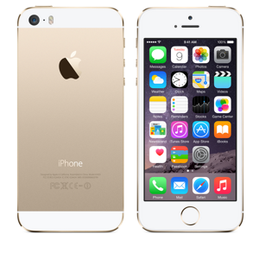
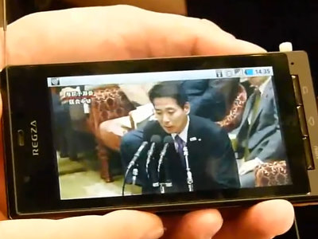
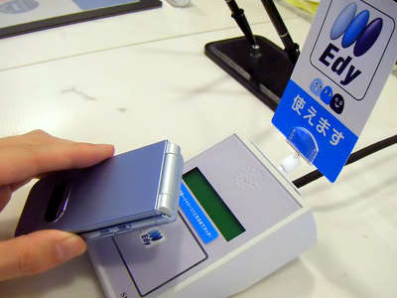
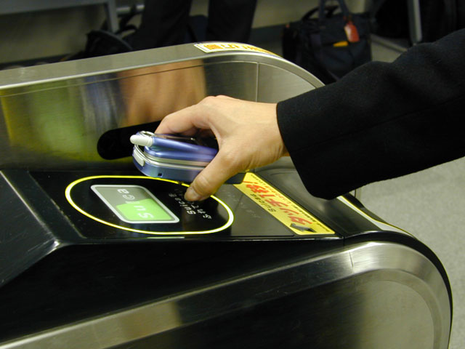
Non-functional Emotional Value：iPhone
Stress-free usability
Cool design
Apple philosophy
etc.
Source: Apple - Press Info
http://gigazine.net
http://www.jalan.net
Source: news.mynavi.jp

Slide 15
Integrated Value of Four Types is Critical
Problem Setting
ART
SCIENCE
Meaning
Subjective
Function
Objective
DESIGN
ENGINEERING
Problem Solving

Slide 16

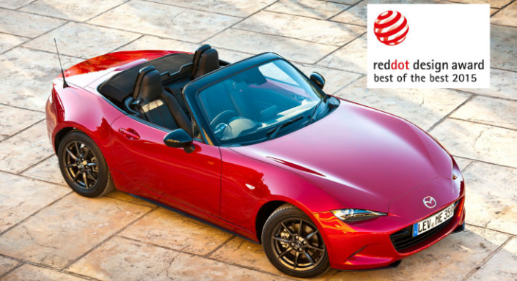
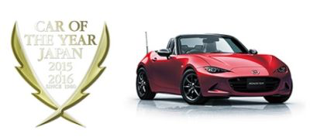
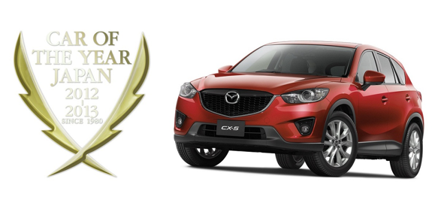
“The Car is Art”: Mazda is Dominating Car Awards
http://www.mazda-press.com/ie/news/all-new-mazda-mx-5-wins-both-2016-world-car-of-the-year-and-world-car-design-of-the-year/
http://super.asurada.com/cars/mazda/2015/18995/
https://www.acnnewswire.com/press-release/english/26951/all-new-mazda-roadster-wins-car-of-the-year-japan
http://www.kotse.com/index.php/news/item/1123-mazda-cx5-jcoty-2012-2013

Slide 17
Financial Performance of MAZDA
Sales
(100 million yen)
Operating Profit
（100 million yen）
PROFITS
First car based on “Art-thinking” Introduced (CX-5)

Slide 18
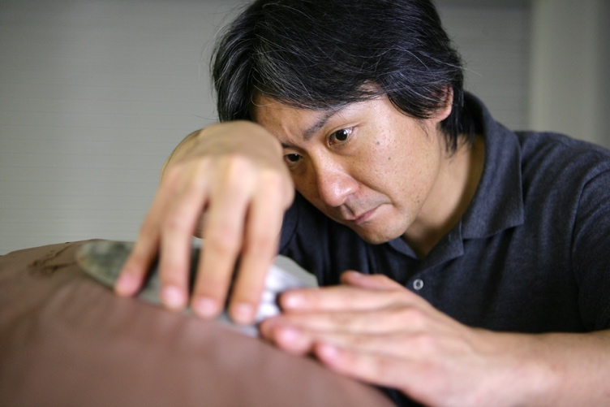
Art-thinking Approach
Express philosophy and emotion rather than customer needs: “KODO”
Go beyond perfection：No Compromise
Ikuo Maeda, General Manager
http://www.mazda.co.jp/beadriver/design/interview/teidan_meisyo_01/
http://www.mazda.com/ja/innovation/design/
Mass Craftsmanship
“Soul of Motion” design embodies the dynamic beauty of wild life.
Artistic clay modelers imbue a car with Soul
http://blog.mazda.com/archive/20140820_01.html

Slide 19

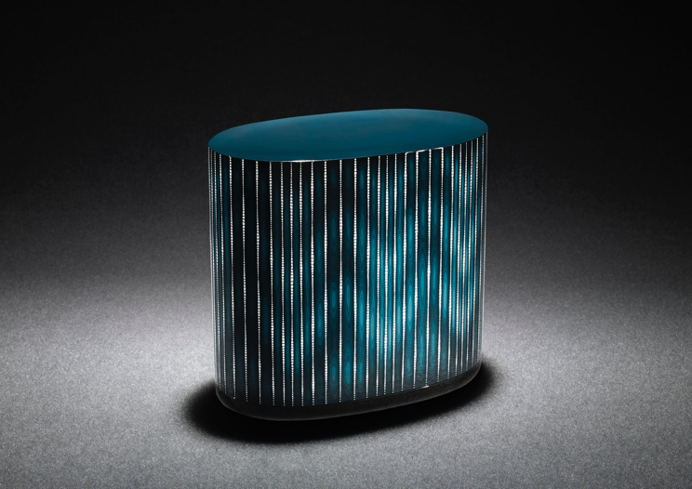
Aesthetics Inspired by Japanese Traditional Arts and Crafts
Joint study regarding expression of “KODO” with Japanese traditional artists
Motoyuki Tamagawa
Gyokusendo’s copperware
Kinjo Ikkokusai III
Raised lacquer design
Source: Provided by Mazda Corporation

Slide 20
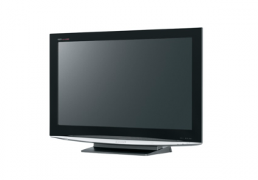
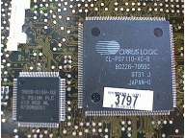
Solution Value: B2B Firm
Customer profit UP
Cost down
Sales up
Profit
Cost
Selling price
Purchase Price (Cost)
Additional
Profit
Supplier Firm
Customer Firm

Slide 21
Highest Performer in Japan: Keyence
Best solution provider in Japan

Slide 22
http://www.keyence.com.sg

Slide 23
Usability: Microscope / Dimension Measurement System
1-hour for 5-year veteran
3-minutes for a new employee
(CEO at Kosaka Iron Works)
http://www.keyence.com.sg

Slide 24
Non-functional Solution Value: Keyence
Solutions for improvement of customer profit and cost
Easy to use and takes short time to learn how to use
Easy to change settings without referring to manual
Customer
Value
Non-func.
Non-func.
Functional
Functional
Competitors
Keyence

Slide 25
Challenges for Asian and Japanese Manufacturers in New Normal Era
Focus on integral design, utilizing superior engineering and manufacturing capabilities
Non-functional subjective customer value must be created in addition to technology-based functional value
Emphasize Asian cultural value
B2C ”Science-Engineering-Design-Art”
B2B Solution (Increase customer profit)

