Slide 1
Key characteristics of innovation in China
Professor Xudong Gao
Tsinghua University Research Center for Technological Innovation
September 2016

Slide 2
Agenda
Impressive achievements
Firm innovation strategies
Both private sector and public sector
Supporting institutions
  Role of government
  Role of higher Education
The future

Slide 3
Impressive achievements
Telecom equipment
  Huawei/ZTE
  3G/4G/5G—China Mobile
High performance computers
High speed railway systems
The military sector

Slide 4
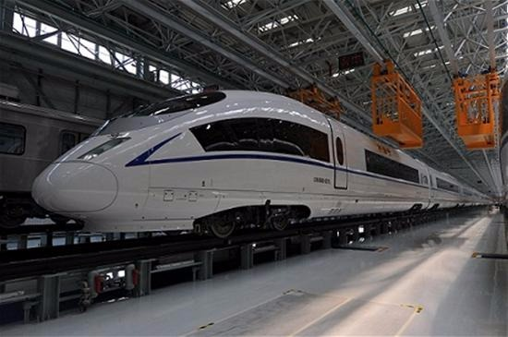
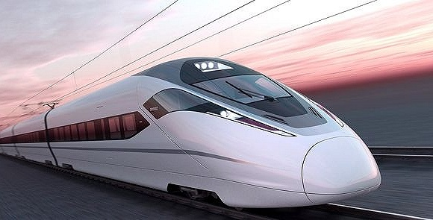

Slide 5
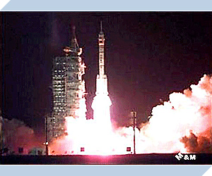

Slide 6
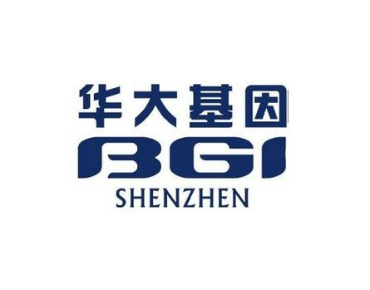
Largest genome sequencing organization

Slide 7
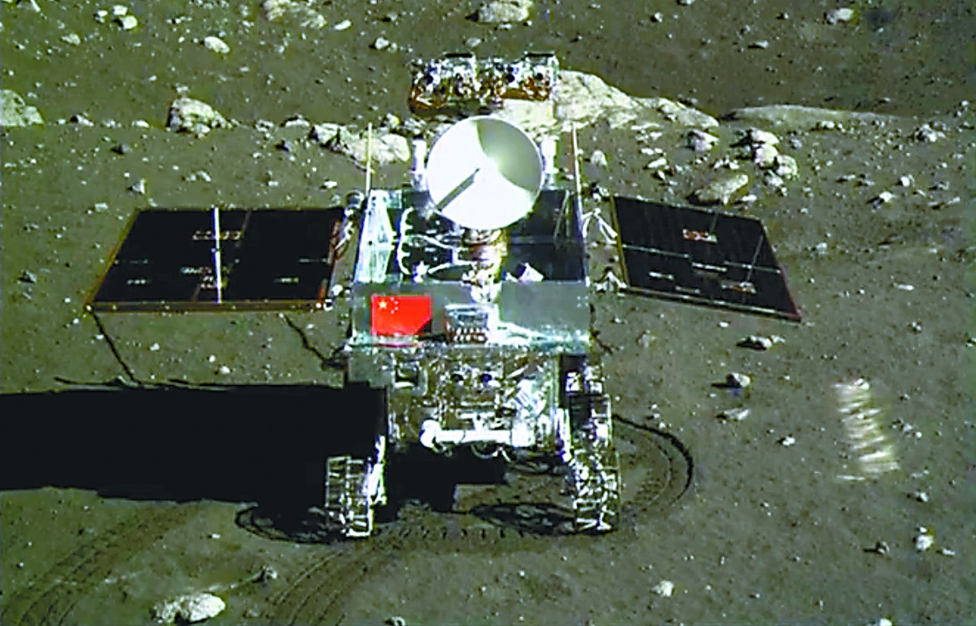

Slide 8
Firm innovation strategies
Appropriate and effective strategies
Strategy I: Technology transfer based Innovation
Strategy II: Indigenous technology development based Innovation
Changing strategies

Slide 9
Strategy I:
Tech transfer based Innovation and Entrepreneurship
Buy technology: The consumer electronics industry
JV: The automobile industry
Technology integration: The VCD/DVD industry
Innovation based on dominant design/International standard : PC

Slide 10
Impressive achievements
Buy technology: The consumer electronics industry
  Brand name
  Scale
  Internationalization
Many #1 in the world

Slide 11
Impressive achievements
JV: The automobile industry
Innovation based on dominant design/International standard : PC
  Lenovo vs. MNEs
Technology integration: The VCD/DVD industry
  Export; Local competition

Slide 12
WTO and strategy I:
Huge challenges
Buy technology
  The consumer electronics industry
  Sony, Samsung vs. Local firms
JV
  The automobile industry
  20% local firms
Technology integration
  The VCD/DVD industry
  High royalty: $26/unit
Innovation based on dominant design/International standard : PC
  The situation is better

Slide 13
Strategy II:
Indigenous technology development based Innovation and Entrepreneurship
ZTE
Huawei
ZPMC
BROAD

Slide 14
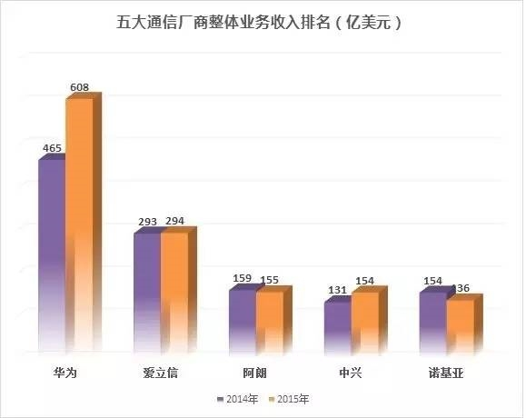
ZTE (1985~) and Huawei (1988~)

Slide 15
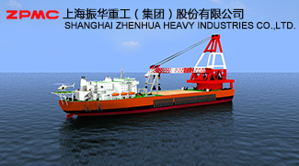
ZPMC
Shanghai Zhenhua Port Machinery Co., Ltd. (ZPMC), was established in 1992 by Mr. Guan, Tongxian at the age of 59 with $1 million.
The largest large-size port container crane maker in the world, and captures more than 70% of the world market.
One of the leaders making spiral bevel gears, making it well positioned in the ocean engineering equipment industry

Slide 16
BROAD
Established in 1988
One of leading Central Air Conditioning systems makers in China
  Price 30% higher than competitors

Slide 17
Key success factors
Technological capability
  R&D investment
  Talented people
  NOT only technology transfer and manufacturing
Clear understanding of advantages and disadvantages
  Latecomer disadvantage
  Low cost + differentiation strategy
Complementary capabilities
Early globalization
Work harder than competitors

Slide 18
R&D investment at Huawei (Billion RMB)
Year | 2000 | 2001 | 2002 | 2003 | 2004 | 2005 | 2006 | 2007 | 2008 | 2009 | 2014 | 2015
(I): Sales Revenue | 22 | 23 | 22 | 32 | 46 | 45 | 66 | 94 | 125 | 149 | 288 | 395
(II):R&D Spending | 2.1 | 3.0 | 3.1 | 3.2 | 4.0 | 4.7 | 5.9 | 7.1 | 10.5 | 13.3 | 40.8 | 59.6
(II)/ (I) (%) | 9.5 | 13 | 14 | 10 | 8.7 | 10.4 | 8.9 | 7.8 | 8.4 | 8.9 | 14.2 | 15

Slide 19
Talented people
ZTE: 18,000 Master/Ph.D.

Slide 20
Clear understanding of advantages and disadvantages
Advantages: Low cost + differentiation strategy
When the former China Unicom decided to build its CDMA network, it invited bids from a group of MNEs in 2000. However, the prices offered by these equipment suppliers were extremely high and the investment would exceed China Unicom’s budget (RMB 20 billion Yuan) dramatically.
China Unicom had to have a new biding in 2001. In the new bidding, ZTE became a big winner
  the equipment offered by ZTE got higher technical evaluation scores than that of most MNEs;
  the low cost structure made it possible for ZTE to offer low price products to China Unicom, and helped China Unicom to save 40% of investment (the real investment was RMB 12.1 billion Yuan, about 8 billion lower than China Unicom’s original budget);
  offering customized technical solutions to China Unicom based on its deep analysis of China Unicom’s business and network

Slide 21
Low cost + differentiation strategy
Multiple networks
ZTE’s SDR base station is able to realize co-existence and smooth evolution between GSM/WCDMA dual model, GSM/WCDMA/LTE multi-mode, and CDMA/LTE dual mode, and could reduce service providers’ Total Cost of Ownership (TCO) about 30%.

Slide 22
Complementary capabilities
Better customer relationships than MNEs through a “comprehensive” approach.
While MNEs and other firms usually focus their customer relationship management on developing close working relationships with managers, especially high level managers of customer firms, Huawei emphasizes the development of close working relationships with ordinary employees such as ordinary engineers of customer firms, believing that ordinary employees of customer firms can also play critical roles.

Slide 23
Early globalization
Accept forced early globalization
  GSM: 5%
  CDMA: 10%
Be willing to accept short term loss
  Huawei began to spend resources on developing the Russian market in 1996, and it took 6 years for Huawei to begin to benefit from this globalization effort
Have a clear understanding about their competitive advantages.

Slide 24
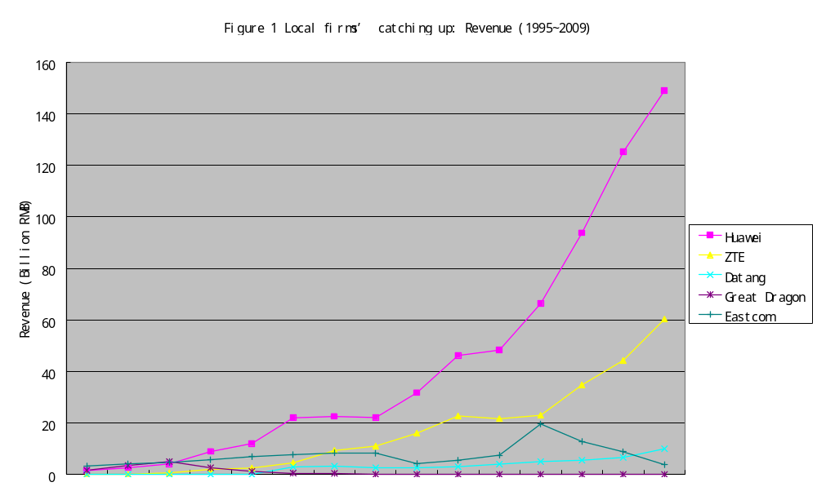

Slide 25


Both private sector and public sector
CNPC, China Mobile, Gridsum, BGI, DJI
GE, Samsung
Metro and high speed railway
Space industry

Slide 26
The role of SOE
2005 vs. 2009
  #: 10.1%~4.7%
  Gross production: 33.3%~26.7%
  Assets: 48.1%~43.7%
  Profits: 44%~26.9%
  Employees: 27.2%~20.4%
2013
  Fortune 500: 89/82
  Total assets : 100 trillion RBM
  Sales: 43.42
  Profit: 2.57
  Tax: 3.72 (12.9)

Slide 27
Strong motivations to innovate
To survive and grow (Chandler, 1997): OLIGOPLICSTIC competition
  Competition
  Buy technology becomes hard/impossible after WTO
Pursuit of ambitious goals by top managers
  Changqing Oilfield (Burgelman, 2002)
Meeting high expectations from the government (and more generally speaking, the society)
  Project Xiqidongshu
  High speed railway systems

Slide 28
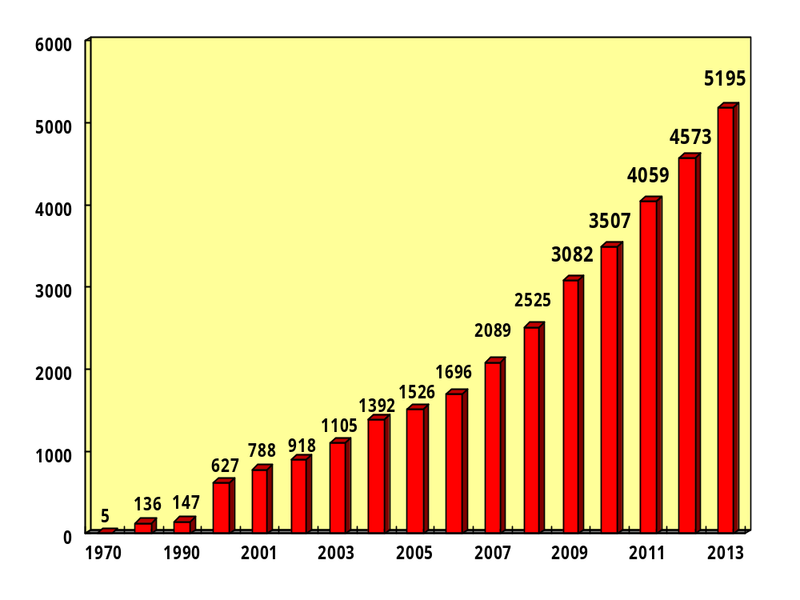

Slide 29
Effective strategies to innovate
(1) making special organizational arrangement,
  setting up high level steering committees and heavy weight teams (Wheelwright and Clark, 1992)
(2) take advantage of being a large integrated company by
  leveraging the integration of user-producer relationship (Lundvall, 1992)
  utilizing internal market to support technological innovation (Japan +Korea experience)
(3)Long term accumulation of technological capability

Slide 30
Big impact of the SOE identity
High expectations and ambitious goals
  113 big SOEs at central government level
  CEOs usually have big opportunities to become very high level government officials in the central government (minister or above)
  These CEOs usually set up ambitious goals for the firm.
Special opportunities
  Project XIQIDONGSHU
  High speed rail way systems

Slide 31
Large integrated firms enjoy advantages in innovation
Supply side
  (1) making high resource commitment—R&D invetment
  (2) making effective use of external technological resources—Outsourcing R&D, State Grid
  (3) special opportunities of technological innovations as an important SOE,
  (4) long term knowledge accumulation: 1950s
Demand/market side
  (5) leveraging the integration of user-producer relationship,
  (6) utilizing internal market to support technological innovation

Slide 32
Supporting institutions
Role of government
Role of higher Education

Slide 33
  Science and technology policy
  Build China into an Innovative country (2006)
    R&D expenditure (%) of GDP: 2006: 1.42; 2009: 1.73%; Increasing at 25.5%
    2014： 2.1%； 2013： 2.08%； 2012: 1.98%; 2010: 1.76%，2011: 1.84%
Science and technology programs
  Program 863 (1986)
  Program Torch (1988)
  Program 973 (1997)
  Program Spark (1985)
  Programs supporting indigenous innovation
    National S&T Major projects

Slide 34





Slide 35
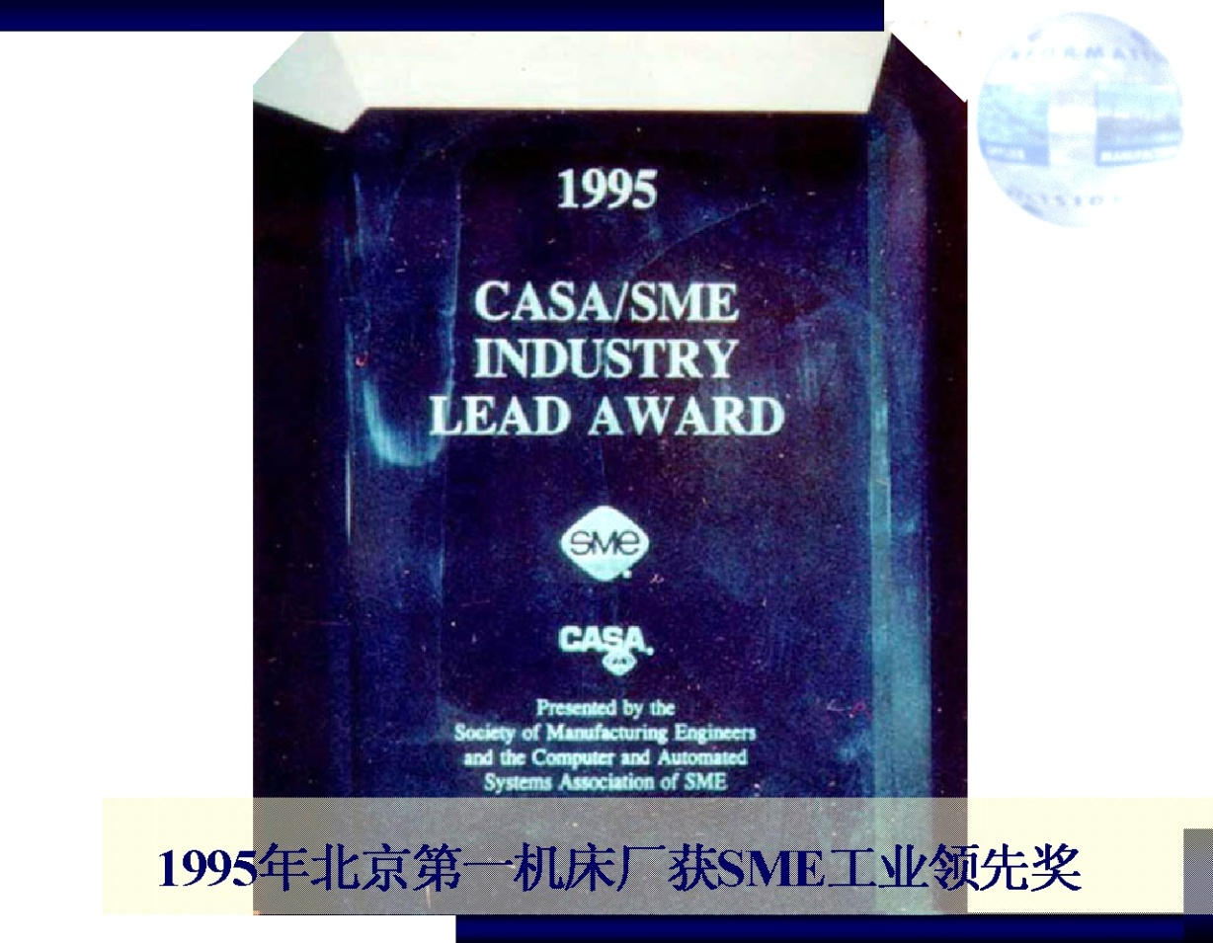
1995年“北京第一机床厂CIMS应用示范工程”获SME工业领先奖

Slide 36
Universities
One of the best higher education systems in the world
  M. of Education
  MIIT: Laser based communications
  CAS, CASS
Program 211, 985, 2011, and…

Slide 37

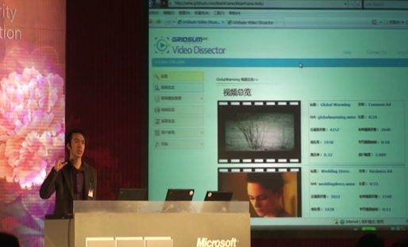
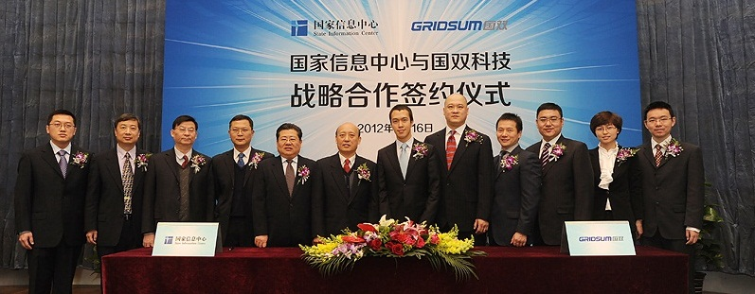

Slide 38

Our flying and camera stabilization systems redefine camera placement and motion.
DJI products are redefining industries. Professionals in filmmaking, agriculture, conservation, search and rescue, energy infrastructure, and more trust DJI to bring new perspectives to their work and help them accomplish feats safer, faster, and with greater efficiency than ever before.

Slide 39
The future
Big opportunities
Qualified education system: from elementary school to higher education
  6m+ college students
High quality manufacturing
  At reasonable cost (not low cost)
New start-ups
  Technology intensive fields

Slide 40
The future
Big challenges
Slow down of domestic economy
  Housing
  Infrastructure
Structural differences
  Telecom in 2014/2015?

Slide 41
Thanks you!
Q&A

